Slide 1

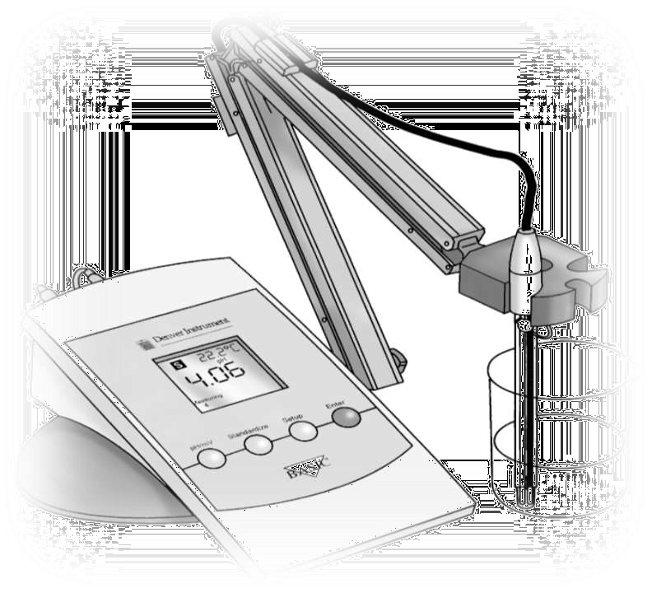
pH Metry

Slide 2
Aim: To study about pH Meter.

Slide 3

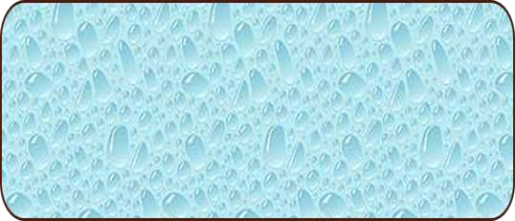
Introduction
The pH meter was invented in 1934 by the American chemist Arnold O. Beckman (1900-2004) to
measure the sourness of lemons.
A simple and speedy device to measure the acidity and alkalinity of a fluid
pH (Potential of Hydrogen):
The logarithm of the reciprocal of hydrogen-ion concentration in gram atoms per litre; provides a measure on a scale from 0 to 14 of the acidity or alkalinity of a solution (where 7 is neutral and greater than 7 is more basic and less than 7 is more acidic)
The formal definition of pH is the negative logarithm of the hydrogen ion activity.
pH = -log[H⁺]

Slide 4
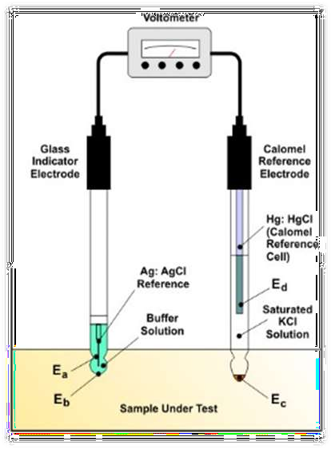

Slide 5

Working Principle of instrument
When a pair of electrodes or a combined electrode( glass &calomel electrode) is dipped in an aqueous solution, a potential is developed across the thin glass of the bulb. The e.m.f of complete cell(E) formed by linking of this two electrodes at a given solution temperature is therefore,
^{E = E}ref ^{– E}glass
^{E} ref
= The potential of stable calomel electrode
which at normal room temp is +0.250V.
= The potential of glass electrode which depends on the pH of the solution under test.
^{E} glass
A pH meter acts as a volt meter that measures the electrical potential difference between a pH electrode and a reference electrode and displays the result in terms of the pH value of the solution in which they are immersed.
An electrical potential develops when one liquid is brought into contact with another one ,but a membrane is needed to keep such liquid apart.

Slide 6

Materials and Method for sample analysis
A pH measurement system consists of
2 probes
Buffer powder/capsules for calibration
High input meter
Distilled water
The pH measuring electrode is a hydrogen ion sensitive glass bulb.
The reference electrode output does not vary with the activity of the hydrogen ion.

Slide 7
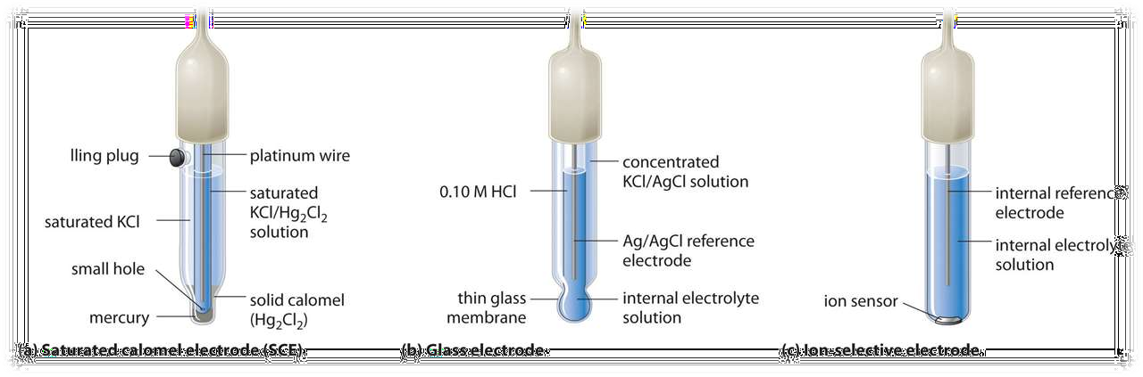
Types of Electrode:

Slide 8

Types of Electrode:
a. Calomel electrode: It consists of a glass tube containing saturated KCL connected to platinum wires through mercury (mercury chloride)
b. Glass electrode: It consists thin bulb of special glass blown(lithium) at the end of the glass tube,and the bulb is filled with dilute acid for example decinormal HCL acid connected to a silver chloride electrode
c. Reference junction: typically made of porous ceramic or porus teflon

Slide 9

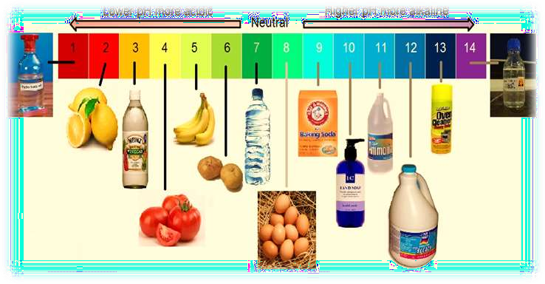
Applications:
Hospitals
Universities
Pharmaceutical companies
Research institutes or laboratories
Measure soil pH for healthier plants.

Slide 10
LOUD SPEAKER

Slide 11
LOUD SPEAKER
When things shake about, or vibrate, they make the sounds we can hear in the world around us.
At the front of a loudspeaker, there is a fabric, plastic, paper, or lightweight metal cone (sometimes called a diaphragm) not unlike a drum skin (colored gray in our picture).
the inner part is fixed to an iron coil (sometimes called the voice coil, colored orange in the diagram) that sits just in front of a permanent magnet (sometimes called the field magnet, and colored yellow).
When you hook up the loudspeaker to a stereo, electrical signals feed through the speaker cables (red) into the coil.
This turns the coil into a temporary magnet or electromagnet. As the electricity flows back and forth in the cables, the electromagnet either attracts or repels the permanent magnet.
This moves the coil back and forward, pulling and pushing the loudspeaker cone. Like a drum skin vibrating back and forth, the moving cone pumps sounds out into the air.

Slide 12
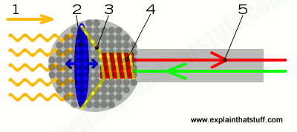
Microphones

Slide 13
Microphones
When you speak, sound waves created by your voice carry energy toward the microphone. Remember that sound we can hear is energy carried by vibrations in the air.
Inside the microphone, the diaphragm (much smaller than you'd find in a loudspeaker and usually made of very thin plastic) moves back and forth when the sound waves hit it.
The coil, attached to the diaphragm, moves back and forth as well.
The permanent magnet produces a magnetic field that cuts through the coil. As the coil moves back and forth through the magnetic field, an electric current flows through it.
The electric current flows out from the microphone to an amplifier or sound recording device. Hey presto, you've converted your original sound into electricity! By using this current to drive sound recording equipment, you can effectively store the sound forever more. Or you could amplify (boost the size of) the current and then feed it into a loudspeaker, turning the electricity back into much louder sound. That's how PA (personal address) systems, electric guitar amplifiers, and rock concert amplifiers work.

